Slide 1
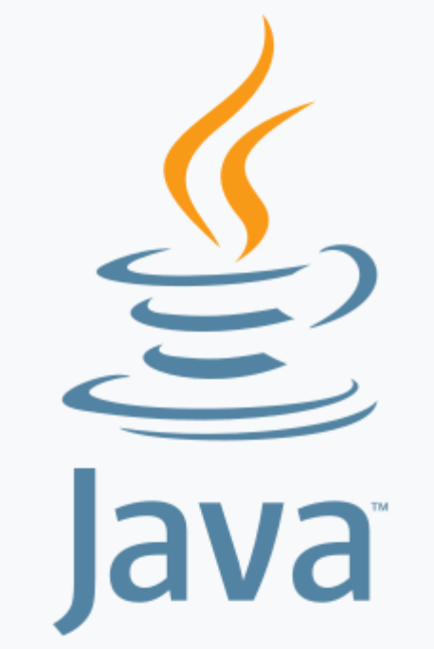
Introduction to Java Java - The Complete Reference Herbert Schildt Chapter 1 and Chapter 2
Notes:
.

Slide 2
Outline
History of Java
Java’s Lineage
What is Java
Java’s Popularity
Java Editions
Java Platform
Java Development Environment
A First Java Program

Slide 3
History of Java
Java was developed primarily by James Gosling at Sun Microsystems in the 1990s.
Java's WORA (write once, run anywhere) principle revolutionized software development by enabling code portability across platforms.
Java gained widespread adoption, powering web applications, enterprise systems, and mobile apps.
Acquired by Oracle in 2010, Java continued to evolve with updates and community contributions.
Java remains a cornerstone in software development, integral to Android OS and prevalent in enterprise environments such as ERP and Financial Systems.

Slide 4
Java’s Lineage
Java is related to C++, which is a direct descendant of C.
Much of the character of Java is inherited from these two languages.
From C, Java derives its syntax.
Many of Java’s object-oriented features were influenced by C++.

Slide 5
What is Java
Java is a versatile, object-oriented programming language renowned for its platform independence, enabling developers to write code once and run it anywhere.
Java encompasses a rich set of features that make it a preferred choice for building diverse software applications across industries:
portability
security
scalability
extensive libraries

Slide 6
Java is Object Oriented
Java is founded on the principles of Object-Oriented Programming (OOP):
Encapsulation allows the bundling of data (variables) and methods (functions) that operate on the data into a single unit known as an object.
Inheritance enables the creation of new classes (subclass) that inherit attributes and behaviors (methods) from existing classes (superclass).
Polymorphism allows objects of different classes to be treated as objects of a common superclass (through method overloading and method overriding)
Abstraction involves hiding the implementation details of a class and exposing only the essential features.
Modularity feature enables Java to organize code into classes and packages.

Slide 7
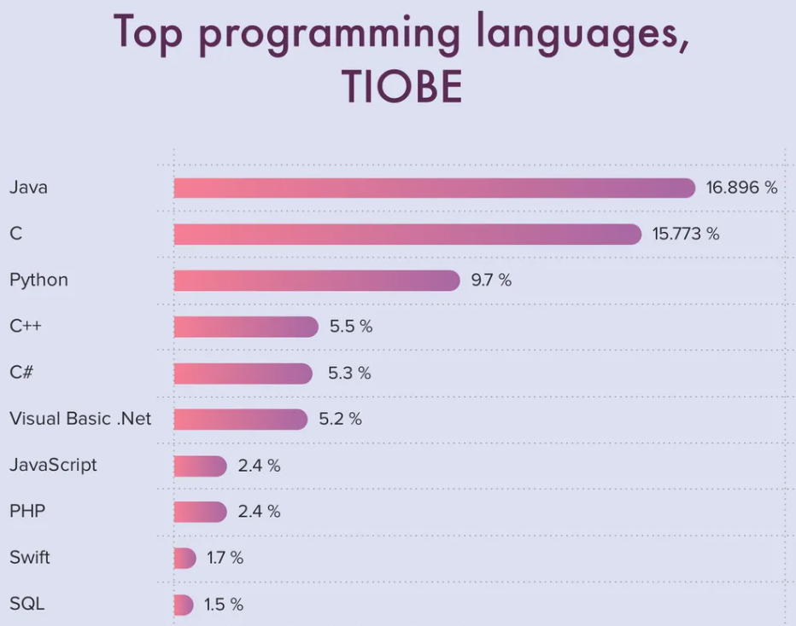
Java’s Popularity
https://www.cleveroad.com/blog/programming-languages-ranking
The TIOBE Programming Community index is an indicator of the popularity of programming languages.
The ratings are based on the number of skilled engineers world-wide, courses and third-party vendors. Popular search engines such as Google, Bing, Yahoo!, Wikipedia, Amazon, YouTube and Baidu are used to calculate the ratings.

Slide 8
Java Editions
Java SE (Standard Edition): Core platform for developing Java applications.
Provides libraries, APIs, and tools for desktop and server environments.
Java EE (Enterprise Edition): Built on Java SE, tailored for enterprise-level applications.
Includes APIs for web services, distributed computing, and enterprise technologies.
Java ME (Micro Edition): Optimized version for resource-constrained devices like mobile phones and embedded systems.
Provides a subset of Java SE APIs for developing mobile and embedded applications.
JavaFX: Platform for creating Rich Internet Applications (RIAs) and desktop applications.
Offers features for multimedia, graphics, and user interfaces.
Java Card: Designed for smart cards and small-memory devices.
Provides a secure execution environment for running Java applications on smart cards.

Slide 9
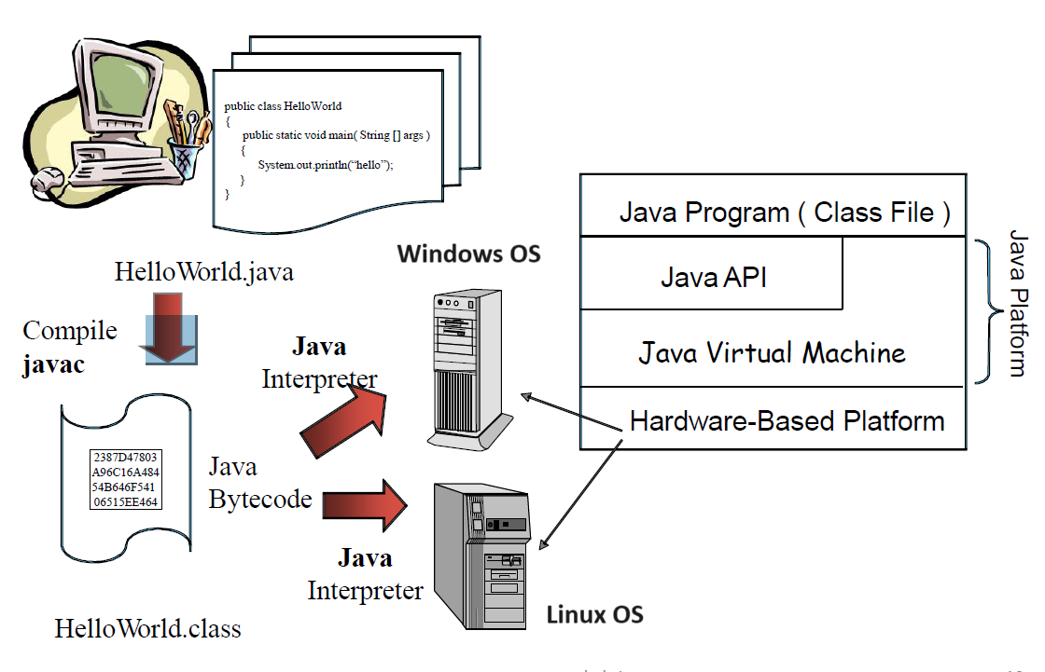
Java Platform

Slide 10
Java Development Environment
Edit
Create/edit the Java source code (.java file)
Compile
Compile the Java source code to generate bytecode (.class file)
Load
Load the compiled code
Verify
Check against security restrictions
Execute
Execute the bytecode

Slide 11
Step 1: Creating a program
Any text editor or Java IDE (Integrated Development Environment) can be used to develop Java programs
Java source‐code file names must end with the .java extension
Some popular Java IDEs:
Eclipse
NetBeans
IntelliJ

Slide 12
Step 2: Compiling a Java Program
Running the Java compiler
javac HelloWorld.java
Searches the file in the current directory
Compiles the source file
Transforms the Java source code into bytecodes
Places the bytecodes in a file named Welcome.class Prepared

Slide 13
Bytecode
Bytecodes are not machine language binary code (like the content of .exe files in Windows OS).
They are independent of any particular microprocessor or hardware platform.
They are platform‐independent instructions.
Another entity (Interpreter) is required to convert the bytecodes into machine codes that the underlying microprocessor understands.
This is the job of the JVM (Java Virtual Machine).

Slide 14
JVM (Java Virtual Machine)
JVM is a part of the JDK (Java Development Kit) and the foundation of the Java platform.
The Java JDK is a software development kit (from Oracle) containing tools, libraries, and documentation necessary for developing, debugging, and deploying Java applications.
https://www.oracle.com/java/technologies/downloads
JVM can be installed separately or with a JDK.
A Virtual Machine (VM) is a software application that simulates a computer system; but hides the underlying operating system and hardware from the programs that runs on the VM (interacts with the VM).
It is the JVM that makes Java a portable language.

Slide 15
JVM (Java Virtual Machine)
The same bytecodes can be executed on any platform containing a compatible JVM.
Different JVM is needed for different operating systems.
The JVM is invoked by the java command:
java HelloWorld
It searches the class HelloWorld in the current directory and executes the main method of class HelloWorld
It issues an error if it cannot find the class HelloWorld or if class HelloWorld does not contain a method called main with proper signature.

Slide 16
Step 3: Loading a program
One of the components of the JVM is the Class Loader.
The Class Loader takes the .class files containing the program bytecodes and copies the content to the RAM.
The Class Loader also loads any of the .class files provided by the Java library that our program uses.

Slide 17
Step 4: Bytecode Verification
Another component of the JVM is the Bytecode Verifier.
Its job is to ensure that bytecodes are valid and do not violate Java’s security restrictions.
This feature helps to prevent Java programs arriving over the network from damaging our system.

Slide 18
Step 5: Execution
Now the actual execution of the program begins.
Bytecodes are converted to machine language suitable for the underlying OS and hardware.
In Summary, Java programs go through two compilation phases:
Source code Bytecodes
Bytecodes Machine codes

Slide 19
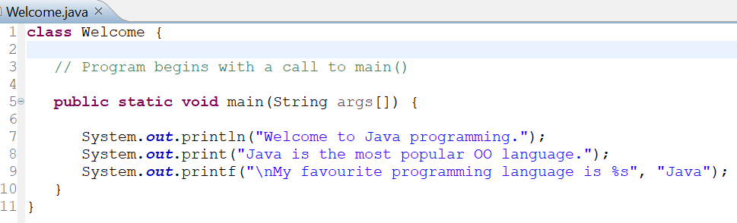
A First Java Program

Slide 20
A First Java Program
A Java source file can contain multiple classes, but only one class can be a public class.
Typically, Java classes are grouped into packages (similar to namespaces in C++).
A public class is accessible across different packages.
The source file name must match the name of the public class defined in the file with the .java extension

Slide 21
A First Java Program
In Java, there is no provision to declare a class, and then define the member functions (called Methods in Java) outside the class.
Body of every member method of a class must be written when the method is declared.
Java methods can be written in any order within the source file.
A method defined earlier in the source file can call a method defined later.

Slide 22
A First Java Program
public static void main(String[] args)
main() is the starting point of every Java application (similar to C/C++).
public is used to make the method accessible by all.
static is used to make main a static method of class Welcome. Static methods can be called without creating/using any object; rather just using the class name. JVM call main using the ClassName.methodName (HelloWorld.main ) notation.
void means main does not return anything (similar to C/C++).
String args[ ] represents an array of String objects that holds the command line arguments passed to the application.
Where is the length of args array?

Slide 23
A First Java Program
Think of JVM as a outside Java entity who tries to access the main method of class Welcome.
main must be declared as a public member of class Welcome.
JVM wants to access main without creating an object of class Welcome.
main must be declared as static
JVM wants to pass an array of String objects containing the command line arguments
main must take an array of String as parameter

Slide 24
A First Java Program
System.out.println()
Used to print a line of text followed by a new line.
System is a class inside the Java API (i.e., Java standard library).
out is a public static member of class System.
out is an object of another class (java.io.PrintStream) of the Java API.
out represents the standard output (similar to stdout in C or cout in C++).
println is a public method of the class of which out is an object.

Slide 25
A First Java Program
System.out.print() is similar to System.out.println(), but does not print a new line automatically.
System.out.printf() is used to print formatted output (similar to printf() in C).
In Java, characters enclosed by double quotes ("") represents a String object, where String is a class defined in the Java API.
We can use the plus operator (+) to concatenate multiple String objects and create a new String object.

